Slide 1
Thanks to: Sumanta Guha
Slide Sources: CLRS “Intro. To Algorithms”

Slide 2
Probability Practice
If the reward for rolling a die is the number of dollars that the face on top shows, what is the expected reward?
  What does this mean? E.g., if this were an actual game how much would you be willing to pay to play?

Slide 3
Probability Practice
If a coin is tossed 5 times, what is the probability of 0 heads, 1 head, 2 heads, …?

Slide 4
Probability Practice
If a coin is tossed 5 times what is expected number of heads?
  What does this mean?
  How do we calculate it? Two ways:
  (a) Let X be the random variable whose value is the number of heads
  E(X) = ∑_{x=0.5} x * Pr(X=x)
  (b) Let X_{i} = I{coin i is heads}
  Note: I(event) = 1, if event occurs; 0, if it doesn’t
  Then X = X₁ + X₂ + X₃ + X₄ + X₅
  Therefore, E(X) = E(X₁) + E(X₂) + E(X₃) + E(X₄) + E(X₅)
indicator variable

Slide 5
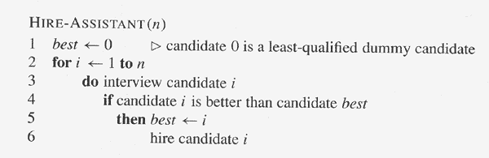
Hire Assistant

Slide 6
Hire Assistant
How many times do we expect to hire a new assistant?
Let X be the random variable whose value is the number of times.
Let X_{i} = I{candidate i is hired}
Then X = X₁ + X₂ + … + X_{n}
Therefore, E(X) = E(X₁) + E(X₂) + … + E (X_{n})
What is E(X_{i}), the probability that the i th candidate is hired? In other words, what is the probability the i th candidate is the best of the first i candidates? Answer: 1/i
Therefore, E(X) = 1 + 1/2 +1/3 + … + 1/n ≈ log_{e} n

Slide 7
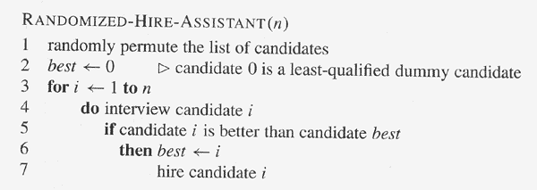
Guarantee randomness, no matter what the input!

Slide 8
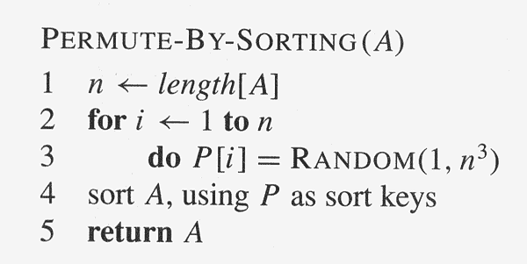
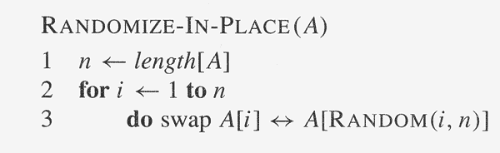
Randomly Permuting the Input Array
Assuming all priorities P[i ] are distinct, prove that the procedure produces
a uniform random permutation.
Prove that the procedure produces a uniform random permutation.

Slide 9
Permutations
5.4.2 Ball and bins
n balls are randomly tossed into b bins.
  Expectedly, how many balls fall into a given bin?
  Expectedly, how many balls must one toss until a given bin is hit at least once?
  Expectedly, how many balls must one toss until every bin is hit at least once?

Slide 10
Permutations, etc
5.4.1 Birthday Paradox
How many people must there be in a room before there is a 50% chance that two share a birthday?

